Slide 1

Elasticsearch - DIY
Dileep Gadiraju

Slide 2
What is Elasticsearch ?
“The world’s leading free and open search and analytics solution with an emphasis on speed, scale, and relevance. It's transforming how the world uses data”
Its built on Apache Lucene library and provides a distributed, multitenant-capable full-text search engine with an HTTP web interface and schema-free JSON documents.

Slide 3

What is Kibana ?
Kibana is an free and open frontend application that sits on top of the Elastic Stack, providing search and data visualization capabilities for data indexed in Elasticsearch

Slide 4
Why Elasticsearch ?
Application Search
Website search
Enterprise search
Logging and log analytics
Infrastructure metrics and container monitoring
Application performance monitoring
Geospatial data analysis and visualization
Security analytics
Business analytics

Slide 5
Components
Index | An index is a logical namespace which maps to one or more primary shards and can have zero or more replica shards.
Type | Data types of fields stored within a index. Examples: date,long,keyword,geo_point,long etc.
Document | Multiple rows or records stored with in index.
Field | Each document is essentially a JSON structure, which is ultimately considered to be a series of key:value pairs
Mapping | Mapping is similar to database schemas that define the properties of each field in the index.
Node | server which stores a data and part of cluster. A special node called co-ordinating node receives client requests.
Cluster | Collection of Nodes (i.e server) , each node contain a parts of cluster data , being data added to cluster.
KQL | Kibana Query Language (KQL) is a simple syntax for filtering Elasticsearch data using free text search or field-based search.
Document Score | Process to determine the relevance of retrieved documents based on user queries, term frequencies, and other important parameters.

Slide 6
Components
Shard | Shards are individual instances of a Lucene index. Each index is comprised of shards across multiple nodes. Types = Primary Shards , Replica Shards.
ILM | Index Lifecycle Management policies to manage indices according to your performance, resiliency, and retention requirements.
Index Template | index template is a way to tell Elasticsearch how to configure an index when it is created

Slide 7
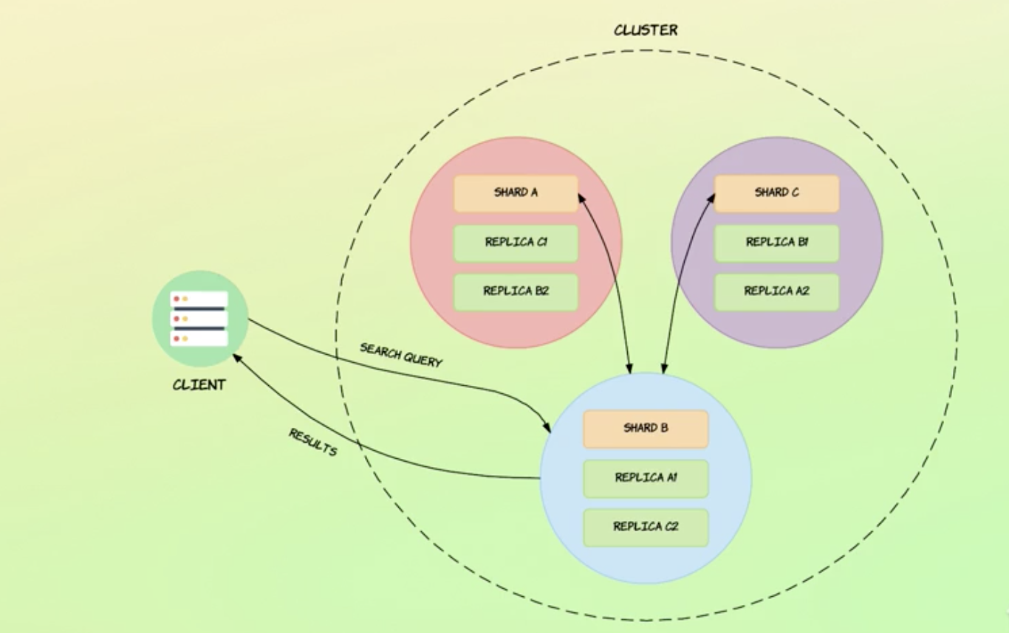
Elasticsearch Architecture

Slide 8
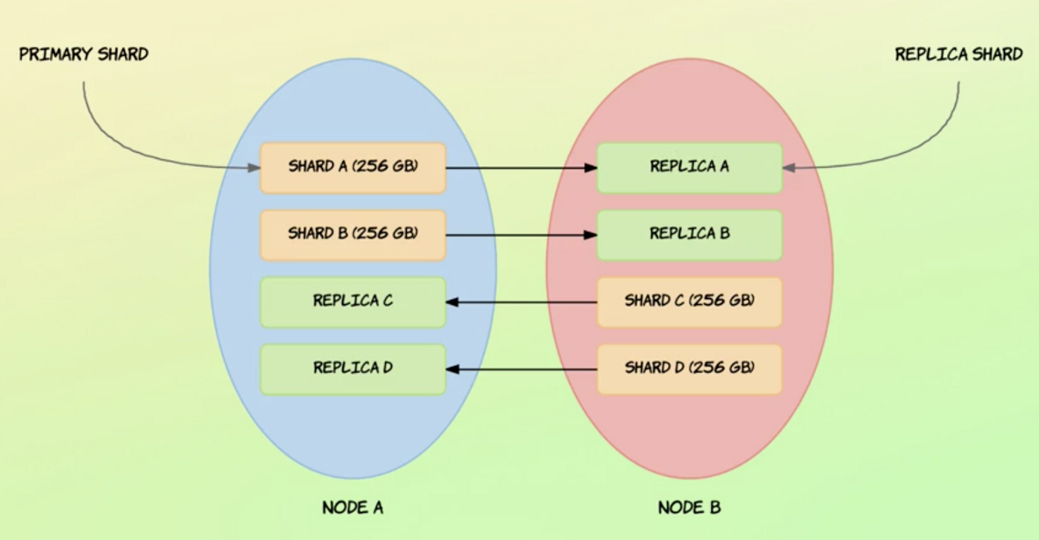
Elasticsearch Sharding

Slide 9
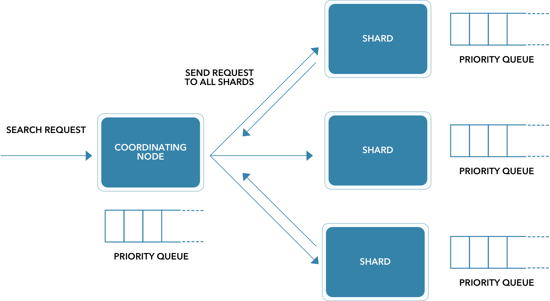
Elasticsearch Architecture

Slide 10
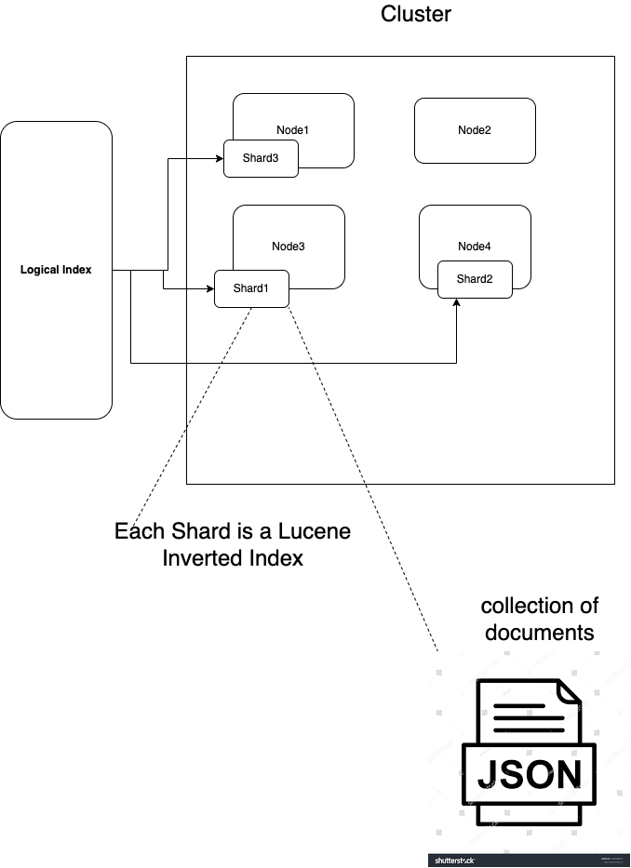
Elasticsearch - Discussion in the Training

Slide 11
What is Analyzer ?
Analyzers are the special algorithms that determine how a string field in a document is transformed into terms in an inverted index.
Types of Analyzers
Standard Analyzer
Simple Analyzer
Whitespace Analyzer
Stop Analyzer
Keyword Analyzer
Pattern Analyzer
Language Analyzer
Fingerprint Analyzer
Custom Analyzer

Slide 12
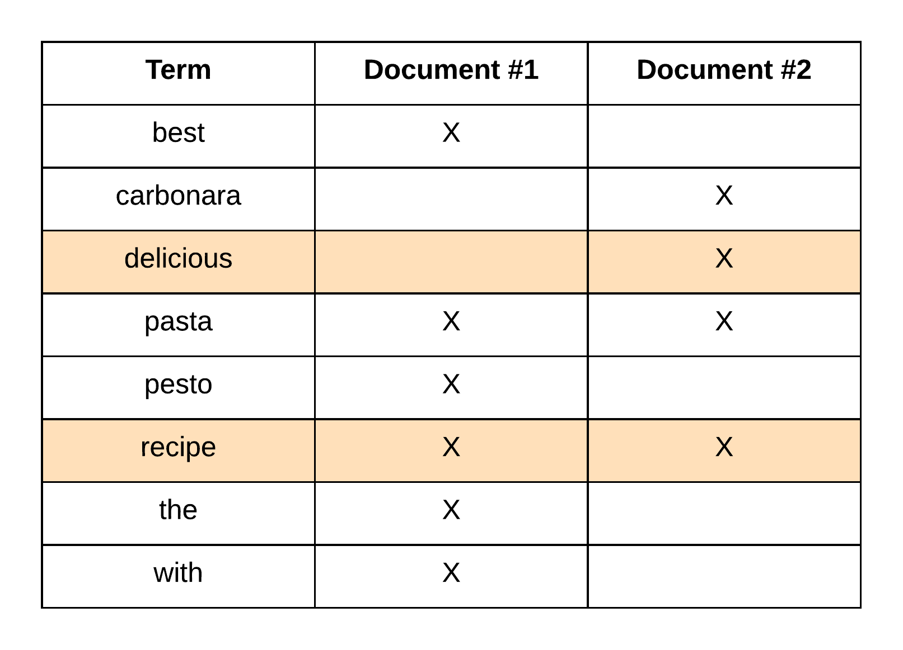
What is Inverted Index ?
Results of Analyzer’s processing stored as Inverted Index. Inverted index is a mapping between terms and which documents contain those terms. Search queries uses inverted indices to fetch document results.
Notes:
A forward index (or just index) is the list of documents, and which words appear in them. Where as Inverted Index is the list of words, and the documents in which they appear.

Slide 13
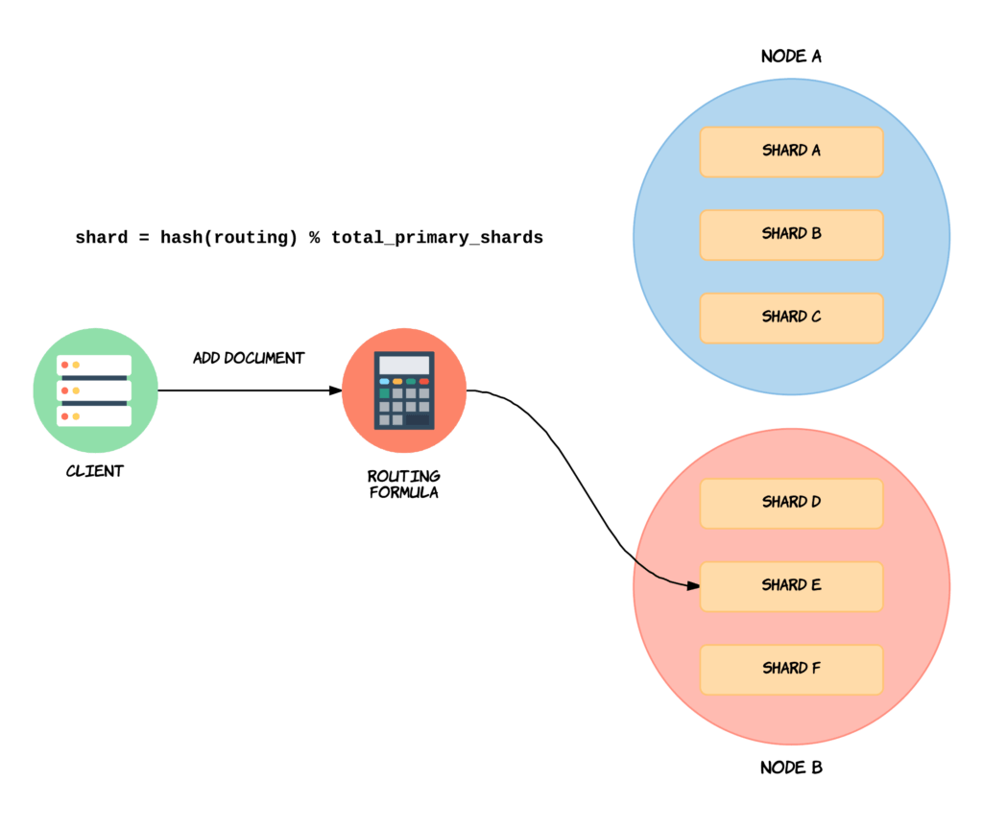
What is Routing ?
Process of determining which shard a document would reside on.
Default routing done based on document id to evenly distribute the documents.
Custom routing can help speed up the search process. For example use user_id or zip code as routing id.

Slide 14
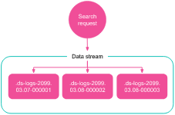
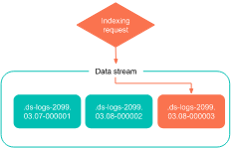
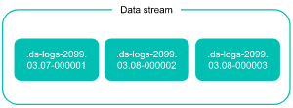
What is Data Stream ?
A Data stream lets you store append-only time series data across multiple indices while giving you a single named resource for requests.
Data streams are well-suited for logs, events, metrics, and other continuously generated data.

Slide 15
What is Nested Type ?
Nested is a special type of object that is indexed as a separate document, and a reference to each of these inner documents is stored with the containing document, so we can query the data accordingly.
Settings:
index.mapping.nested_fields.limit
index.mapping.nested_objects.limit

Slide 16
Basic Query Constructs
must | AND condition
should | OR condition
filter | Filter non matching documents without impacting document scores. Frequently used filters will be cached automatically by Elasticsearch, to speed up performance
must_not | NOT condition
match | Returns documents that match a provided text, number, date or boolean value. The provided text is analyzed before matching.
match_phrase | All terms + Order + Without other intervening words. For example match_phrase search for “Hello World” would return document with “I Just said hello world”
term | Returns the documents where the value of a field exactly matches the criteria with score.

Slide 17
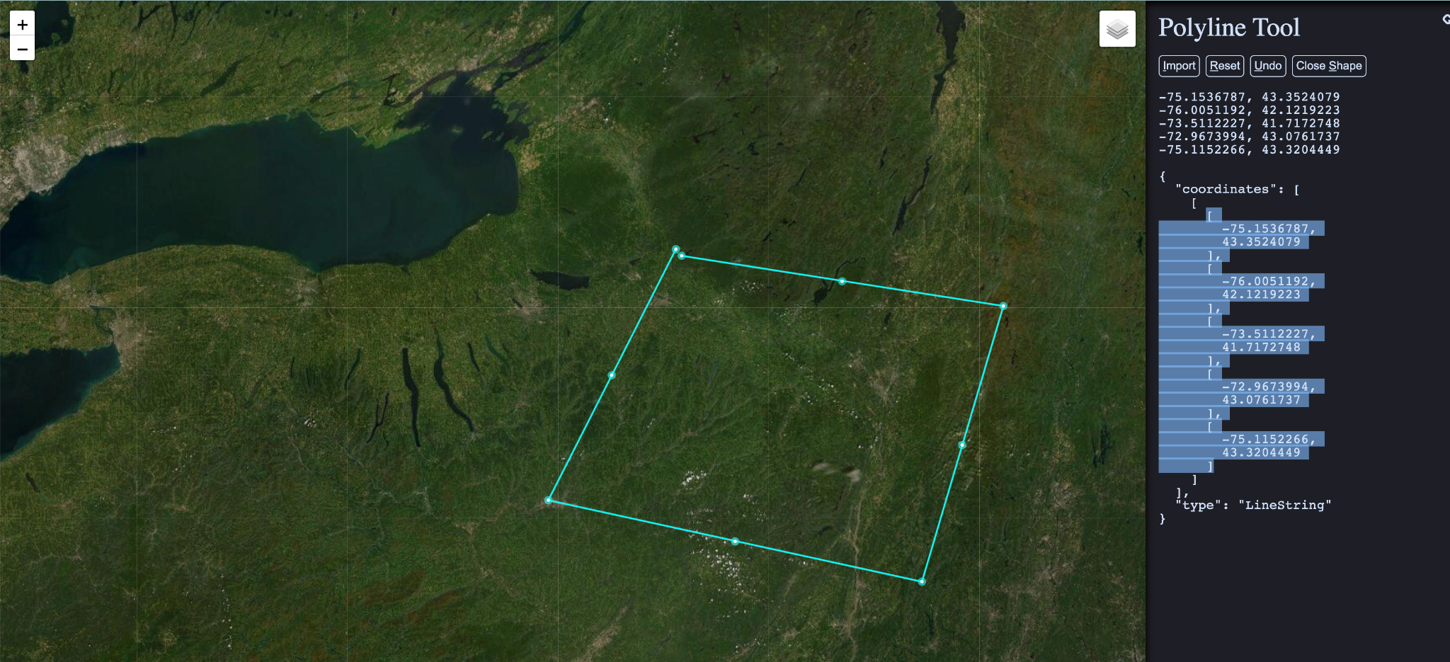
Geo Queries
geo_distance
geo_polygon
geo_distance_range
geo_bounding_box
Geo_shape
Notes:
https://www.keene.edu/campus/maps/tool/

Slide 18
Rest APIs
POST /_aliases
GET /_all/_mapping
GET _search
GET /_cat
GET _cat/indices
GET /_cat/aliases
GET /_cat/health
GET /_cat/nodeattrs
GET /<index name>/_settings
POST /<index name>/_doc
POST _analyze
POST /<index>/_analyze
GET /_index_template
GET /_data_stream
GET /_ilm/policy
POST _bulk
POST /<index>/_update/<_id>
POST /<index>/_update_by_query

Slide 19
Demo
https://github.com/dileep-gadiraju/elastic-search-training

Slide 20
Q&A

Slide 21
Thank you!

